Slide 1
10 Search Engine Optimization (SEO) tips

Slide 2
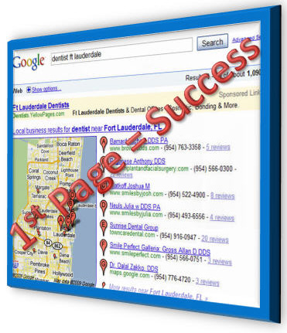
How does Google choose search winners and losers?

Slide 3

1. Monitor where you stand
You won't know if your SEO efforts are working unless you monitor your search standings. Keep an eye on your page rank with tools like Alexa and the Google toolbar.
It's also important to check your referrer log regularly to track where your visitors are coming from and the search terms they're using to find your site.

Slide 4
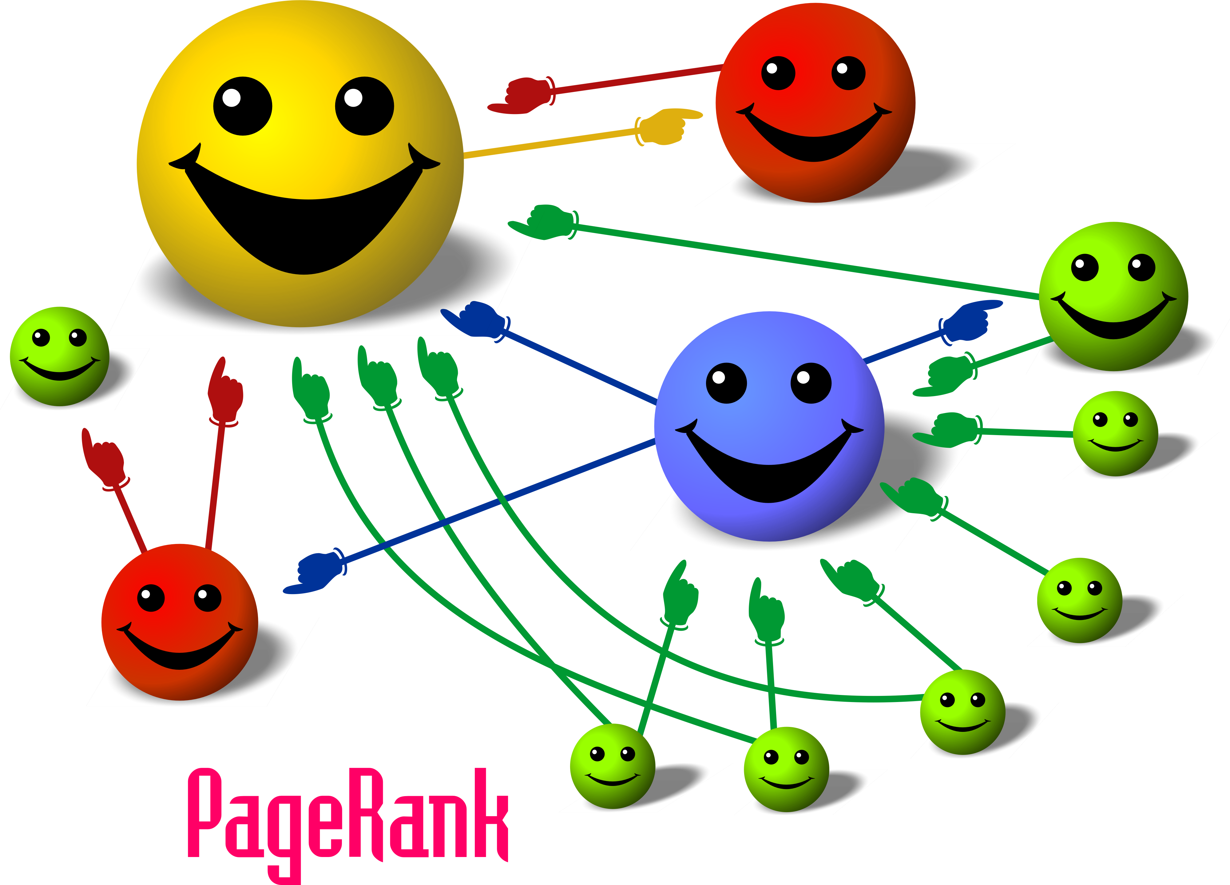
2. Links from other sites

Slide 5

Link to others
An easy way to direct more traffic to your site is by developing relationships with other sites.
PC World suggests that you personally ask the webmasters of well-respected sites if they'll include a link to your site on theirs. Be sure to return the favor -- then everyone wins!
Make certain that your partner has a good web-reputation, of course. MarketingVox warns against getting tied to a "link farm" whose bad SEO habits could bring you down.

Slide 6

3. Good Content

Slide 7
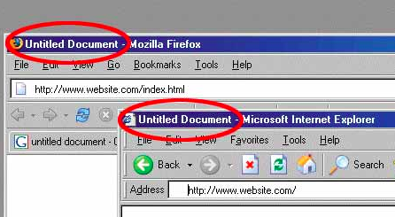
4. Choose a descriptive page title

Slide 8

5. Include Keywords in the article
You should be conscious of placing appropriate keywords throughout every aspect of your site: your titles, content, URLs, and image names. Think about your keywords as search terms -- how would someone looking for information on this topic search for it?
The title tag and page header are the two most important spots to put keywords, PC World notes.
BEWARE: Putting ridiculous amounts of keywords on your site will get you labeled as a spammer, and search engine spiders are programmed to ignore sites guilty of "keyword-stuffing." Be strategic in your keyword use.

Slide 9

6. Search-friendly URLs
Make your URLs more search-engine-friendly by naming them with clear keywords.
‘www.puppyfun.co.uk/puppyhealth/vitamins’
Is better than
‘www.puppyfun.co.uk/11789/s201.htm’

Slide 10

Link back to yourself
There is probably no more basic strategy for SEO than the integration of internal links into your site -- it is an easy way to boost traffic to individual pages.
You should make it standard to link back to your archives frequently when creating new content. MarketingVox advises that you also make the anchor text search-engine-friendly: "The more relevant words point to a page, the more likely that page is to appear in search results when users run a query with those terms."
As with all other SEO approaches, be sure your links are appropriate, and be careful not to cross the line into excessive linking -- you don't want your visitors to get annoyed.

Slide 11

Create a sitemap
Adding a site map -- a page listing and linking to all the other major pages on your site -- makes it easier for spiders to search your site.
"The fewer clicks necessary to get to a page on your website, the better," advises MarketingVox.

Slide 12

7. Don’t rely on Flash to get Google’s attention
Flash might look pretty, but it does nothing for your SEO.
Search engines read text.

Slide 13

8. Image descriptions
Spiders can only search text, not text in your images -- which is why you need to make the words associated with your images as descriptive as possible.
Start with your image names: adding an "ALT" tag allows you to include a keyword-rich description for every image on your site. Perfect Optimization explains an easy way to do this.
The visible text around your images is valuable for SEO: MarketPosition suggests adding captions to all your pictures and being descriptive with the text in immediate physical proximity to your images.

Slide 14

9. Fresh content
Your content needs to be fresh -- updating regularly and often is crucial for increasing traffic.
"The best sites for users, and consequently for search engines, are full of oft-updated, useful information about a given service, product, topic or discipline," MarketingVox explains.
One way to ensure that your site gets new content on a frequent basis is to integrate a blog. "Get the owner or CEO blogging. It’s priceless!" the Search Engine Journal suggests. An executive blog is an excellent way to reach out to your clients, create more opportunities for internal and external linking, while giving your site a more personal voice.

Slide 15

10. Social media distribution
A CEO blog is just one element of social media distribution, an important SEO strategy according to SEO Consult. You should be distributing links to fresh content on your site across appropriate social networking platforms.
Whether displayed on your company's account, or recommended, re-tweeted, and re-distributed by someone else, this strategy exponentially muliplies the number of places where visitors will view your links.

Slide 16
SEO Tools
Alexa Rank and Tools
http://www.alexa.com/topsites
Inbound Links
http://www.wholinks2me.com/
Google Keywords
http://www.google.com/adwords/

Slide 17
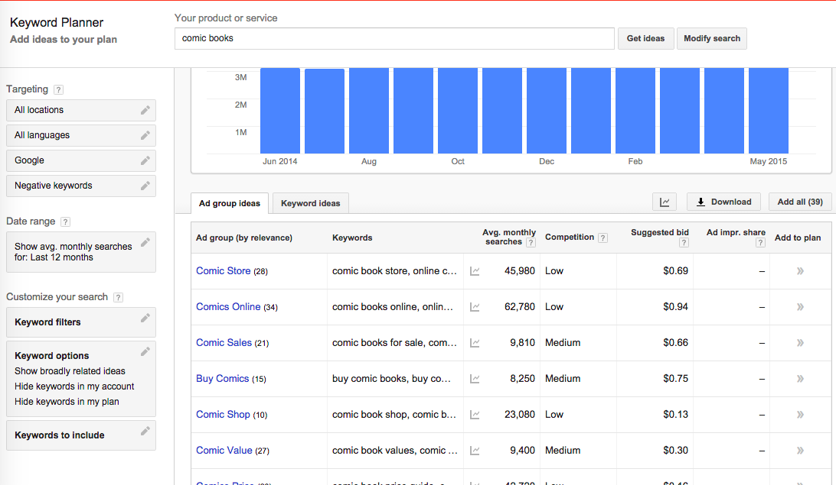
Google Keyword Tools

Slide 18
Backlinks Experiment
Open the site http://www.wholinks2me.com/
Enter a URL for your school. How many backlinks does it have? _______
Enter a URL for a well-known site such as www.nytimes.com How many inbound links does it have? ________
If both your school site and the NY Times published an article about “Tips for graduation”, which would show higher in Google’s search results? __________

